Slide 1
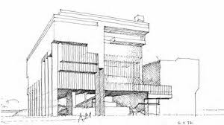
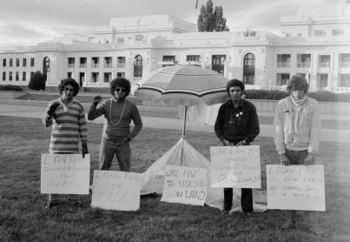
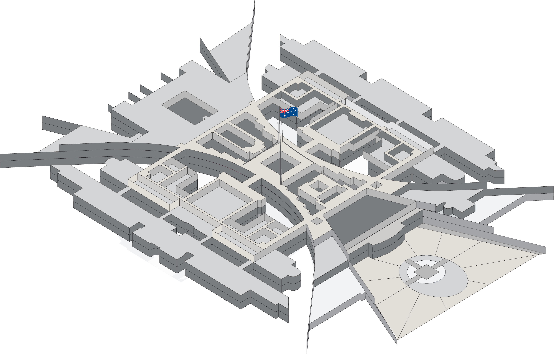
The Politics of Justice Reinvestment in Australia
Cameron Russell
Deakin Uni
Supervisors:
Assoc Prof Clare Farmer, Deakin Uni
Dr Mark Wood, Deakin Uni
Prof Stuart Kinner, Curtin Uni
ANZSOC Conference 2025
QUT Brisbane

Slide 2
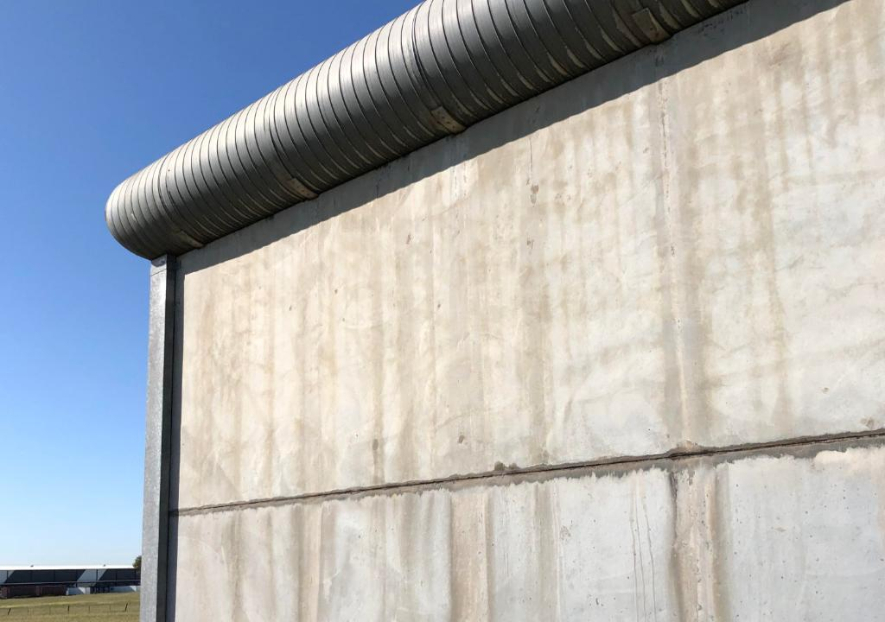

Acknowledgement of Country
I acknowledge and pay my respects to past, present and emerging Elders and Custodians of the land on which we meet, that of the Turrbal and Yugara peoples. Their stolen lands have never been ceded.

Slide 3
Overview
Thesis: “Strengths-based strategies for justice investment, reinvestment & diversion (JIRAD) in Australia”
Focus today: “The politics of JR/JIRAD in Australia”
How do our predecessors in JR differ from us?
What do our political parties think about JR?
How does politics affect the JR definition, and how can our JR definition be adjusted to close the gap?

Slide 4
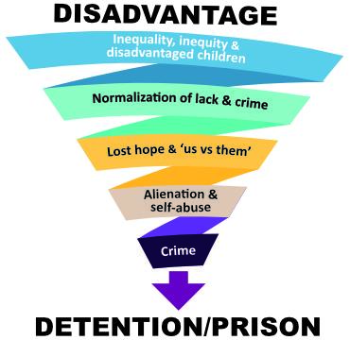
The downward spiral to prison
In these disadvantaged postcodes:
Low high school completion rates
Low employment rates
Low opportunity & income levels
Poor sport & recreational facilities
Poor physical and mental health
High substance abuse rates
High homelessness rates
High levels of boredom & trauma
Leading to:
High crime & incarceration rates
Costly & ineffective imprisonment
High recidivism rates
(Glass 2015; Vinson 2007; Vinson & Rawsthorne 2015:27-43;115; Grimsrud & Zehr 2002; Calma 2009)

Slide 5
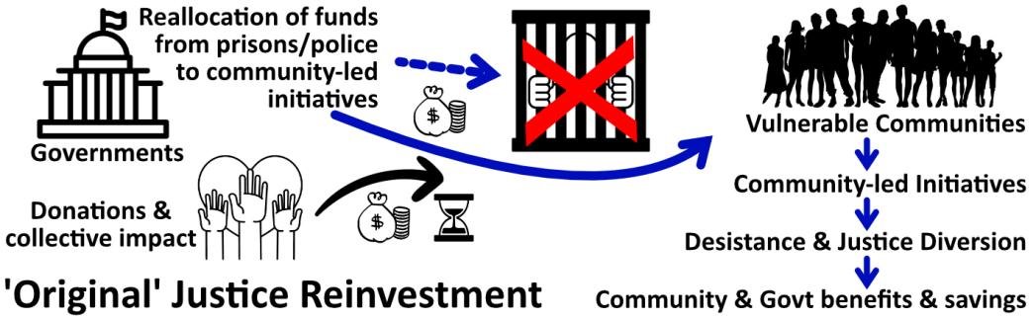
‘Justice reinvestment’ (JR) original definition
JR involves the reallocation of funding from prisons/ police to community-led initiatives that strengthen the social fabric & address the causes of crime. Prisons & police are then less needed (Tucker & Cadora 2003).

Slide 6
Differences in JIRAD application
 | United States | England & Wales | Australia
1st major JR initiative | JR initiatives, Connecticut (from 2002) | The Local Justice Reinvestment Pilot, at Greater Manchester and 5 London boroughs (from 2011) | The Maranguka Justice Reinvestment Project, Bourke, NSW (from 2012)
What they have in common | Govt funds are often directly invested (as opposed to reinvested) in community initiatives to alleviate the causes of crime. The communities benefit and the savings (e.g. from the reduced need for police & prisons) are mostly absorbed by the govt
How their focus is different | Govt focus is reform of the CJS & reducing govt spending, with the savings being absorbed by govt | Govt focus is often social impact bonds (or payment-by-results or pay-by-outcome contracts) - payment by govt upon a corporation achieving specified criminal justice outcomes. Savings are typically absorbed by govt & corporations (not the community) | Govt focus has been on social justice, mostly in remote communities with a high First Nations population, with the aim of addressing disadvantage & closing the gap
 | (Allen and Stern 2007) | (Wong et al. 2013) | (Ferguson and Lovric 2019)

Slide 7
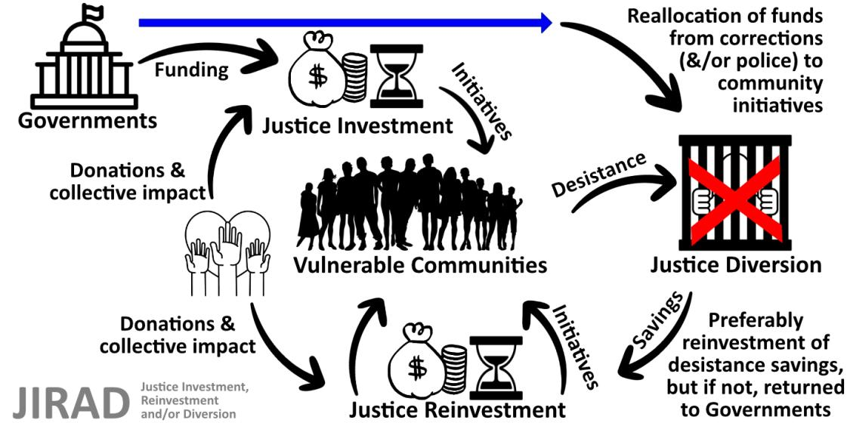
Justice investment, reinvestment and diversion (JIRAD)

Slide 8
Govt positions on JR (1)
The main Federal, State & Territory party positions on justice reinvestment (ALP, LNP & Greens, so n=27) and the One Nation position (n=1) were sought in 2025. The NT Greens did not have a relevant spokesperson so the total sought was n=27. n=21 responses (78%) were received (for party details, refer to aprj.com.au).

Slide 9
Govt positions on JR (2)
Findings:
  All but one party spoke positively about JR
  All parties positive about the need for crime prevention, early intervention & JR-type initiatives
  76% of parties mentioned the overrepresentation of First Nations people in the CJS & closing the gap
  One party identified as ‘tough-on-crime’; six parties mentioned being against ‘tough-on-crime’ or for ‘smart-on-crime’; & 13 parties unclear (but not ‘soft’)

Slide 10
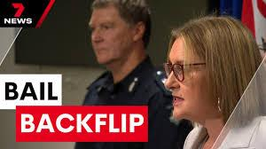
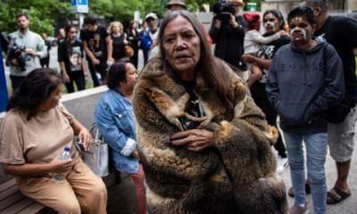
JR and community safety
Tough vs safety
Smart… with safety
E.g. Building a sports complex >
active & confident (rather than bored) young people >
upward spiral > desistance >
positive outcomes >
improved community safety

Slide 11
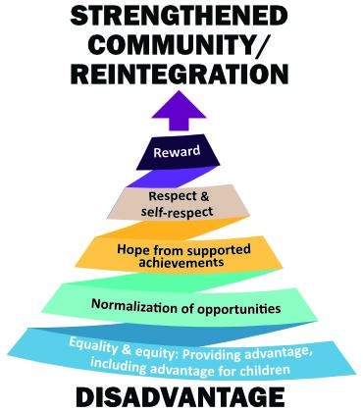
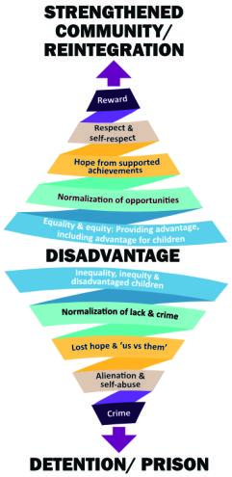

The upward spiral to reintegration
(Vinson 2007; Calma 2009)

Slide 12
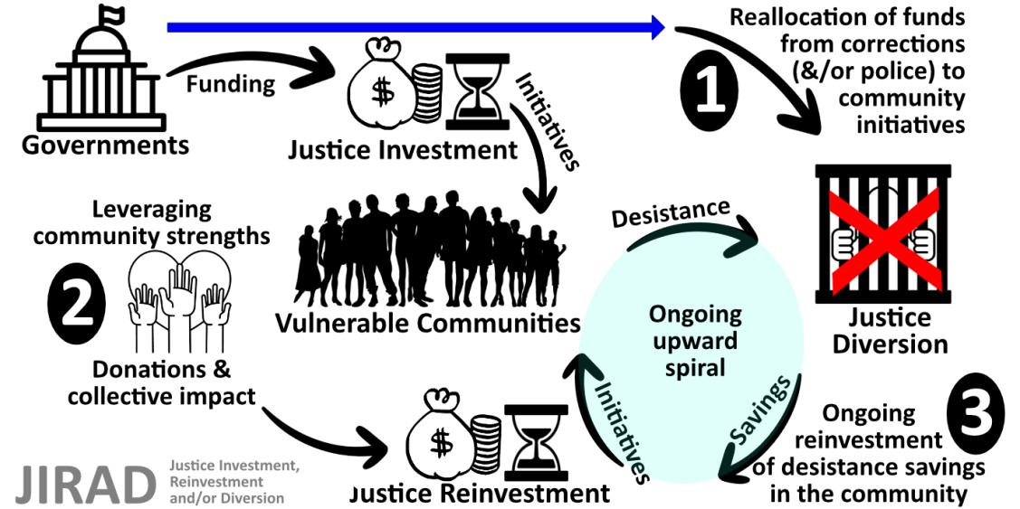
Three political issues

Slide 13
Issue 1: No reallocation from prisons/police
What the governments in Australia label as “justice reinvestment funding” is almost always “justice investment” &/or “justice diversion”
Most “justice reinvestment funding” misses the key element in the original definition: funding reallocation
Govts have changed the definition of JR to exclude reallocation, so “reinvestment” meaningless

Slide 14
Issue 1 (cont.): No reallocation from prisons/police
If no reallocation from prisons/police, there is lost chance to:
  reduce our reliance on incarceration and police
  access additional funds from the criminal justice budget
Projected prison costs have sometimes been reallocated to JR initiatives with the result that the planned prisons did not need to proceed. For example:
  Tas Govt’s 2024 decision to close Ashley Youth Detention Centre; not construct a 270-bed northern prison; & invest in therapy & rehabilitation
  Connecticut with 2000-bed shortfall went from being one of the fastest growing to one of the fastest shrinking prison systems following JR
  10 prisons closed in North Carolina after 3-yr JR
  25.8% decarceration & 1:7 savings in Pennsylvania after 5-yr JR
  (Allen and Stern 2007; DOJ 2014; Barnett 2019)

Slide 15
Issue 2: Strengths a gap in the literature
Thesis:
“Strengths-based strategies for justice investment, reinvestment & diversion (JIRAD) in Australia”
Notes:
  Western criminology & related applied social sciences such as psychology and sociology tend to focus on a need/issue & attempt to meet/solve it
  But needs-based focus can ignore strengths-based JR
  Most Australian JR initiatives have been launched by & in remote Aboriginal communities that use local strengths

Slide 16
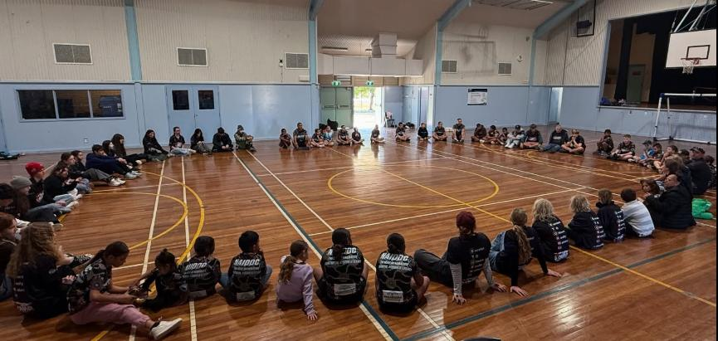
Issue 2 (cont.): Strengths a gap in the literature
Sitting in a yarning circle after a sports event, Maranguka JR initiative, Bourke

Slide 17
Issue 2 (cont.): Strengths a gap in the literature
Improvements from justice reinvestment in 2017:
  A 38% reduction in charges across the top five juvenile offence categories; 27% reduction in juvenile bail breaches; 31% increase in year 12 retention rates; and 84% rise in the completion rate for VET courses by Bourke secondary school students
  83% increase in licences through a Learner Driver Program
  23% reduction in police-recorded domestic violence incidents
  AUD 3.1 million gross impact, with only AUD 0.6 million operational costs. Two thirds of this impact benefitted the justice system and the other third benefitted the region economically.
(KPMG 2018)

Slide 18
Issue 3: No ongoing reinvestment of savings
Simple e.g. of the reinvestment of desistance savings:
2017: Govt invests $1m in JR in Bourke
Results in $5.1m gross impact and positive outcomes for the community, so ROI of $4.1m
Benefits to justice system = $2.7m
Benefits to community = $1.4 m
Govt reinvests either $2.7m or $4.1m
2018: Assuming cost-benefit reduced to 1:4, community has either ROI of $10.8m or $12.3m (etc)

Slide 19

Conclusion
Types of community strengths accessed in JIRAD initiatives:
(a) community spirit, heritage and shared values/vision
(b) community character (e.g. creative, tight-knit, brave, resilient, loyal)
(c) respected elders, other leaders & dedicated people with talents
(e) cooperating non-profits, support services, businesses & police
(f) cultural assets (e.g. rock art, historical sites, local knowledge)
(g) natural assets (e.g. river, sea, park, bush, rock, wildlife)
(h) built assets (e.g. sports complex, schools, shops, hospital, library)
(i) community access (e.g. to digital resources, horses, motor bikes, camps)
(j) events (e.g. art exhibitions, concerts, festivals, football, picnic races)

Slide 20

Thank you
Cameron Russell

Slide 21
Selected references
Allen R and Stern V (eds) (2007) Justice reinvestment – A new approach to crime and justice, International Centre for Prison Studies, King’s College London, London.
ALRC [Australian Law Reform Commission] (2018) ‘”What is Justice Reinvestment?” Pathways to justice: Inquiry into the incarceration rate of Aboriginal and Torres Strait Islander Peoples’, ALRC Report 133.
Barnett J (2019) ‘Does justice reinvestment work?’, Commonwealth Foundation.
Calma T (2009) ‘Social Justice Report 2009’, Aboriginal and Torres Strait Islander Social Justice Commissioner, Australian Human Rights Commission, Sydney.
Department of Justice (2014) ‘Justice reinvestment in North Carolina: Three years later’, NCJ No. 248498.
Ferguson A and Lovric J (2019) ‘Maranguka justice reinvestment’, Human Rights Defender, 28(3):23-25.

Slide 22
Selected references (cont.)
Glass D (2015) ‘Investigation into the rehabilitation and reintegration of prisoners in Victoria‘, Victorian Ombudsman (16 September 2015).
Grimsrud T and Zehr H (2002) ‘Rethinking God, Justice, and Treatment of Offenders’, Journal of Offender Rehabilitation, 35(3):253-279.
Just Reinvest NSW (n.d.) ‘Bourke (Maranguka): Ngemba Country (‘caring for others’, Just Reinvest NSW, accessed 31 August 2025.
KPMG (2016) ‘Unlocking the Future: Maranguka Justice Reinvestment Project in Bourke Preliminary Assessment’, KPMG.
KPMG (2018) ‘Maranguka Justice Reinvestment Project: Impact Assessment’, (Audit Report), KPMG.
Maranguka Limited (n.d.) ‘2023-2025 Maranguka Limited: Strategic Plan’, Maranguka Community Hub, Bourke, NSW, Australia.
Sacred Sports (2025) ‘Sacred Sports: Background’, Sacred Sports, Bourke, Australia.

Slide 23
Selected references (cont.)
Tucker SB and Cadora E (2003) ‘Ideas for an Open Society: Justice Reinvestment: To Invest in Public Safety by Reallocating Justice Dollars to Refinance Education, Housing, Healthcare, and Jobs’, Open Society Institute 3(3):1-5.
Vinson T (2007) Dropping off the edge: The distribution of disadvantage in Australia, Jesuit Social Services, Richmond, Victoria, Australia.
Vinson T and Rawsthorne M (2015) ‘Dropping off the Edge: Persistent communal disadvantage in Australia’, Jesuit Social Services, Richmond, Victoria, Australia.
Wong K, Meadows L, Warburton, F, Webb, S, Young H and Barraclough (2013) ‘The development and Year One Implementation of the Local Justice Reinvestment Pilot’, Hallam Centre for Community Justice, Sheffield Hallam University.

Slide 24
Image credits
Aboriginal Tent Embassy: The Tribune/SEARCH Foundation; Mitchell Library, State Library of NSW, established 26 January 1972; photograph 27 January 1972.
Aunty Donna Nelson (Veronica’s mother) rebuking Victorian Premier Jacinta Allen for bail laws backflip: The Guardian, 12 March 2025.
Australian Parliament House: PEO (Parliamentary Education Office - peo.gov.au), 2025.
Bail laws backflip: 7 News, 13 August 2024.
Banksy mural: “Create Escape”, mural painted on the wall of the former Reading Prison (as a likely reference to Oscar Wilde and others who were imprisoned there), CNN, 5 March 2021.
Children in a circle: Sacred Sports, 2025.
High Court of Australia: National Library of Australia archive, Trove, 1980.
Rock art: Tasmanian Tiger, Murujuga Sea Country, Dampier Archipelago, Australian Geographic.
Spiral infographics: SlideModel.com, royalty free for subscribers.
All other photographs: Taken by the author, 2022-2025.

